Slide 1
NP-Completeness

Slide 2
NP-Completeness
Almost all the algorithms we have studied thus far have been polynomial-time algorithms: on inputs of size n, their worst-case running time is O(n^{k}) for some constant k.
There are computational problems that can not be solved by algorithms even with unlimited time.
For example Turing Halting problem (Given a program and an input, whether the program will eventually halt when run with that input, or will run forever).

Slide 3
Limitation of a Computer
Alan Turing proved that general algorithm to solve the halting problem for all possible program-input pairs cannot exist.
Generally, we think of problems that are solvable by polynomial-time algorithms as being tractable, or easy, and problems that require superpolynomial time as being intractable, or hard.

Slide 4
NP-Completeness
NP complete problems are problems whose status is unknown.
No polynomial time algorithm has yet been discovered for any NP complete problem, nor has anybody yet been able to prove that no polynomial-time algorithm exist for any of them.
The interesting part is, if any one of the NP complete problems can be solved in polynomial time, then all of them can be solved.

Slide 5
NP, P, NP-complete and NP-Hard problems
P is set of problems that can be solved by a deterministic Turing machine in Polynomial time.
NP is set of decision problems that can be solved by a Non-deterministic Turing Machine in Polynomial time.
P is subset of NP (any problem that can be solved by deterministic machine in polynomial time can also be solved by non-deterministic machine in polynomial time).
Informally, NP is set of decision problems which can be solved by a polynomial time via a “Lucky Algorithm”, a magical algorithm that always makes a right guess among the given set of choices.

Slide 6
NP, P, NP-complete and NP-Hard problems
NP-complete problems are the hardest problems in NP set. A decision problem L is NP-complete if:
1) L is in NP (Any given solution for NP-complete problems can be verified quickly, but there is no efficient known solution).
2) Every problem in NP is reducible to L in polynomial time.
A problem is NP-Hard if it follows property 2 mentioned above, doesn’t need to follow property 1.
Therefore, NP-Complete set is also a subset of NP-Hard set.

Slide 7
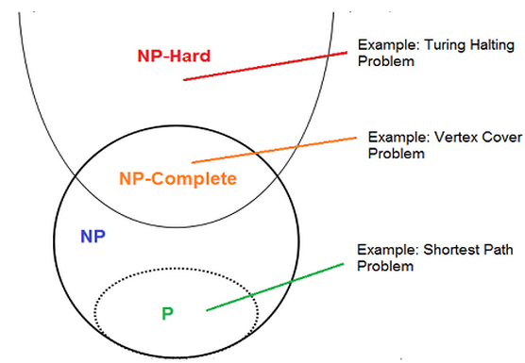
NP, P, NP-complete and NP-Hard problems

